Slide 1
NYC Taxi data project
Presentation
Ruize Xuan

Slide 2
Outline
Introduction
Data Visualization
Data Cleaning
Idea / Data validation
Method and model
Result
Conclusion

Slide 3
Introduction
The goal for this analysis to use the New York City Taxi dataset to evaluate the potential information leakage from the Federal Reserve around FOMC meetings along unofficial channel.
The filtered sample is from more than ten years taxi records in New York. Each row contains one taxi trip.

Slide 4
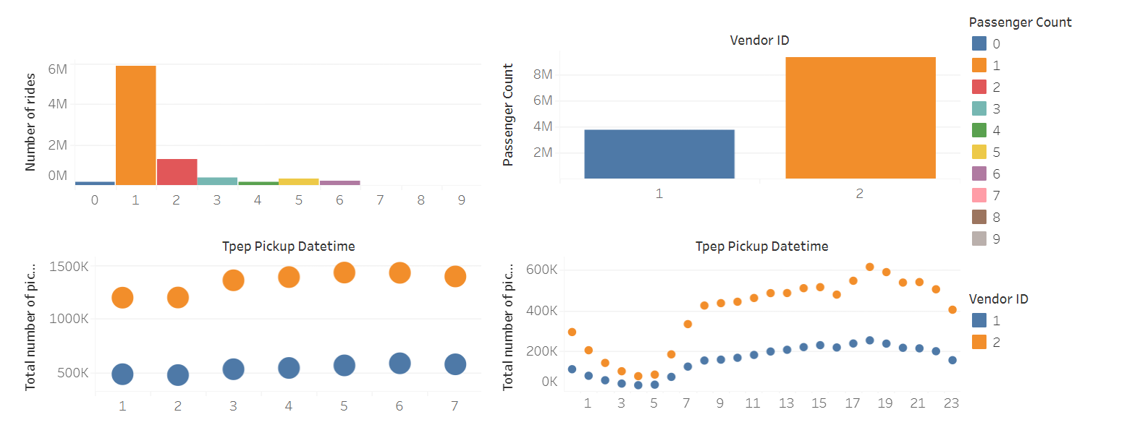
Data Visualization
I find:
There are a few trips with zero, or seven to nine passengers.
The vast majority of rides had only a single passenger, with two passengers being the second most popular option.
Towards larger passenger numbers we are seeing a smooth decline through 3 to 4.
Vendor 2 has significantly more trips in this data than vendor 1.
We find an interesting pattern with Monday being the quietest day and Friday very busy.

Slide 5
Data Cleaning
Extreme trip duration
Longer than one day
These value should be removed
Close to 24 hours
We will remove trip_durations longer than 22 hours
Shorter than a few minutes
Zero distance
Short trips (limits)

Slide 6
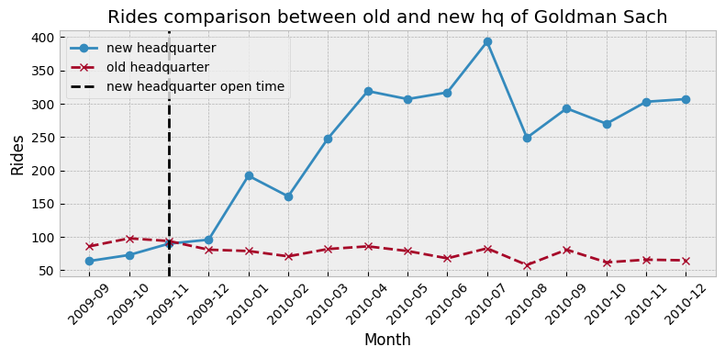
Data Validation

Slide 7
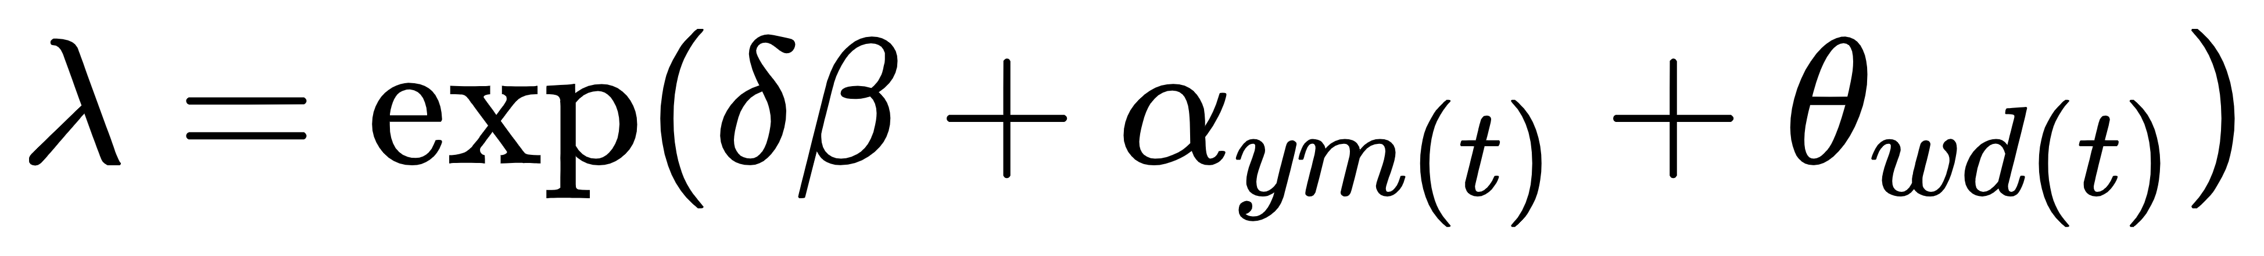



Method and model
It’s a Poisson regression.
is the number of rides.
is the indicator if the date t is within FOMC window.
is the effect of year of month.
is the effect of weekday.

Slide 8
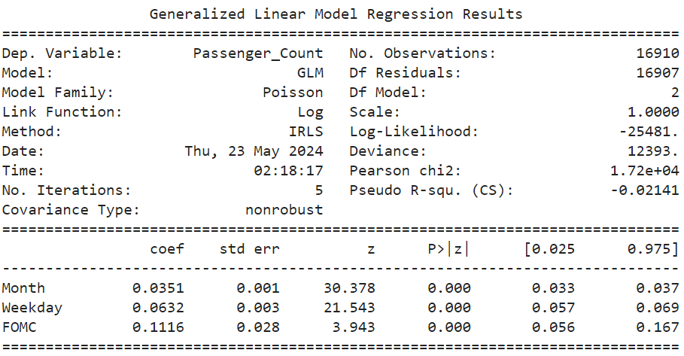
Result

Slide 9
